Slide 1


UNIVERSITY INSTITUTE OF ENGINEERING
COMPUTER SCIENCE & ENGINEERING
Introduction to Information Security
(Subject Code:20CST-354/ITT-354)
Prepared By : Er. Puneet kaur(E6913)
INTRODUCTION
DISCOVER . LEARN . EMPOWER

Slide 2

Authentication Requirements
www. cuchd.in Campus : Gharaun, Mohali

Slide 3
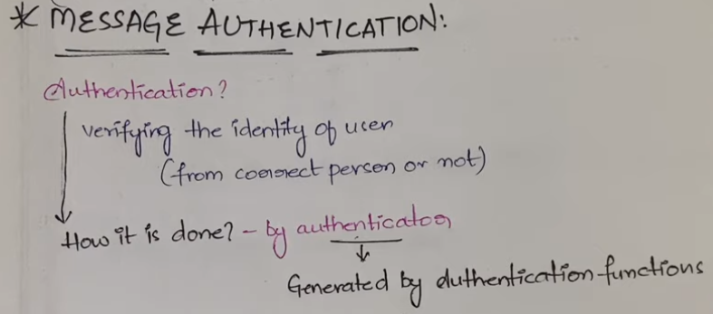

Slide 4
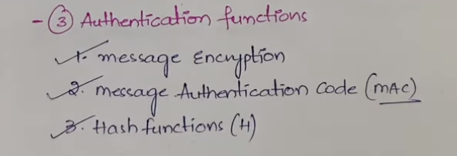

Slide 5
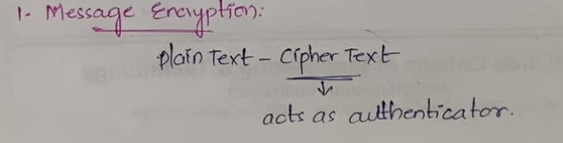

Slide 6
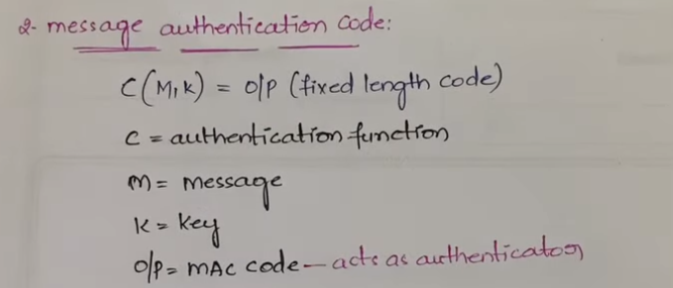

Slide 7
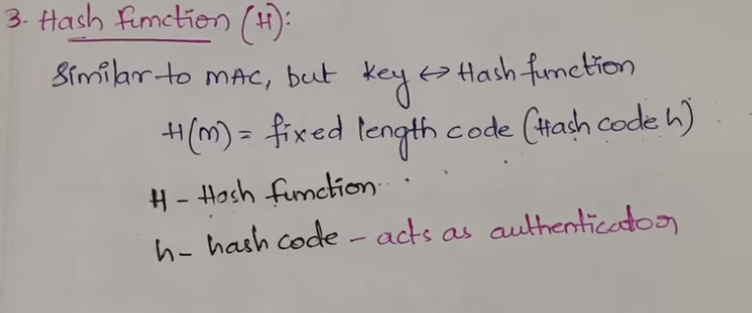

Slide 8
Message authentication
Message authentication is a procedure to verify that received messages come from
the alleged source and have not been altered. Message authentication may also verify
sequencing and timeliness. A digital signature is an authentication technique that also includes measures to counter repudiation by either source or destination.

Slide 9
Authentication Functions Types
Message Encryption: The ciphertext of the entire message serves as its authenticator.
2. Message Authentication Code1 (MAC): A public function of the message and
a secret key that produces a fixed length value that serves as the authenticator.
3. Hash Functions: A public function that maps a message of any length into a
fixed length hash value, which serves as the authenticator.

Slide 10
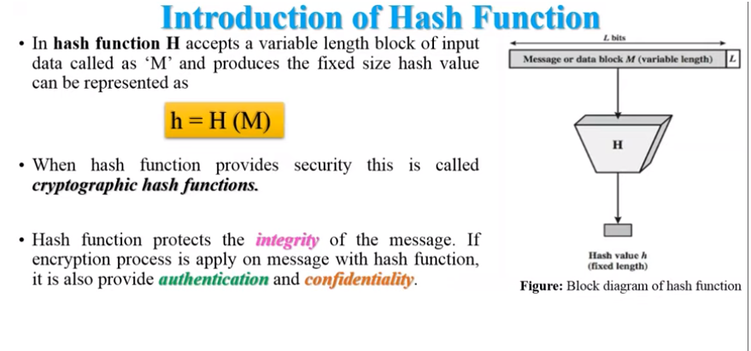

Slide 11
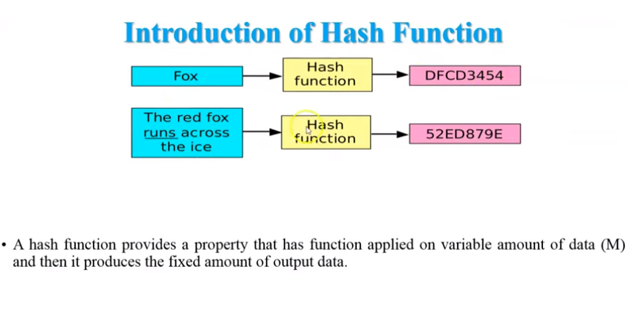

Slide 12
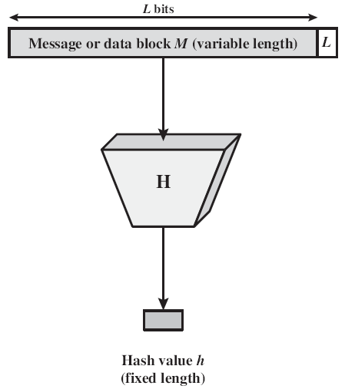
General Operation of Cryptographic Hash Function
Input is padded to an integer multiple of some fixed length
Padding includes the value of the length of the original message in bits.
The length field is used to increase the difficulty for an attacker to produce an alternative message with the same hash value.

Slide 13
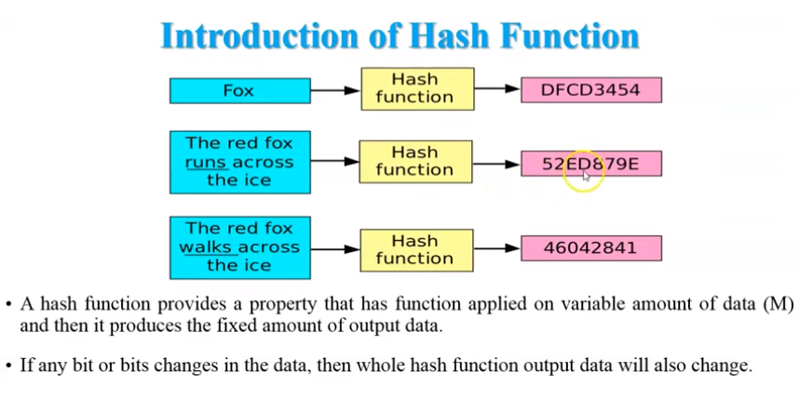

Slide 14
Features of Hash Functions
Fixed Length Output (Hash Value)
Hash function coverts data of arbitrary length to a fixed length. This process is often referred to as hashing the data.
In general, the hash is much smaller than the input data, hence hash functions are sometimes called compression functions.
Since a hash is a smaller representation of a larger data, it is also referred to as a digest.
Hash function with n bit output is referred to as an n-bit hash function. Popular hash functions generate values between 160 and 512 bits.
Efficiency of Operation
Generally for any hash function h with input x, computation of h(x) is a fast operation.
Computationally hash functions are much faster than a symmetric encryption.

Slide 15
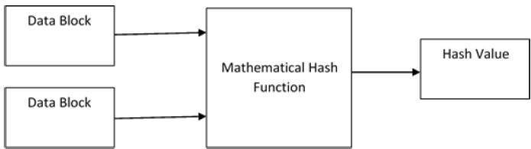
Design of Hashing Algorithms
At the heart of a hashing is a mathematical function that operates on two fixed-size blocks of data to create a hash code. This hash function forms the part of the hashing algorithm.
The size of each data block varies depending on the algorithm. Typically the block sizes are from 128 bits to 512 bits. The following illustration demonstrates hash function −
[4]

Slide 16
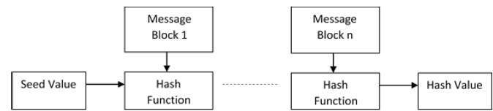
Design of Hashing Algorithms
Hashing algorithm involves rounds of above hash function like a block cipher. Each round takes an input of a fixed size, typically a combination of the most recent message block and the output of the last round.
This process is repeated for as many rounds as are required to hash the entire message. Schematic of hashing algorithm is depicted in the following illustration −

Slide 17
Popular Hash Functions
Message Digest (MD) MD5 was most popular and widely used hash function for quite some years. The MD family comprises of hash functions MD2, MD4, MD5 and MD6. It was adopted as Internet Standard RFC 1321. It is a 128-bit hash function.
Secure Hash Function (SHA) Family of SHA comprise of four SHA algorithms; SHA-0, SHA-1, SHA-2, and SHA-3. Though from same family, there are structurally different.
The RIPEMD is an acronym for RACE Integrity Primitives Evaluation Message Digest. This set of hash functions was designed by open research community and generally known as a family of European hash functions.

Slide 18

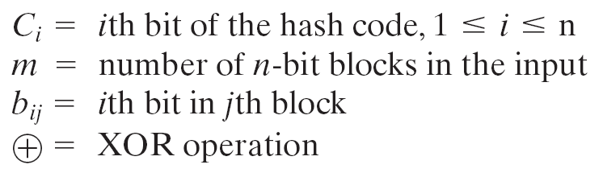
Simple Hash Functions
One of the simplest hash functions is the bit-by-bit exclusive-OR (XOR) of every block.

Slide 19
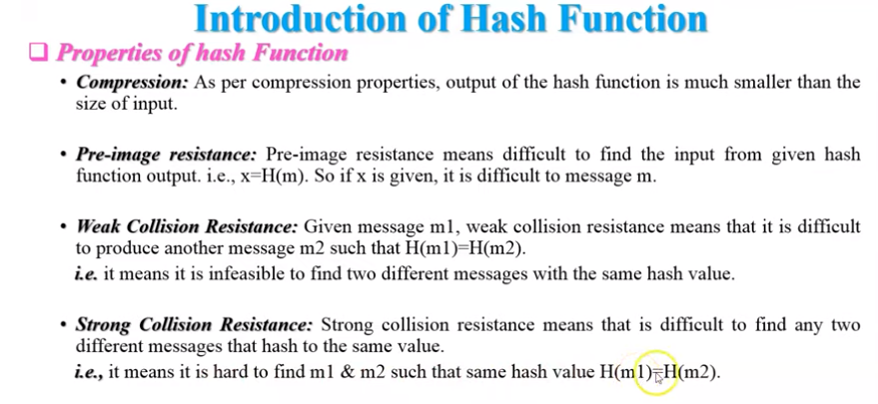

Slide 20
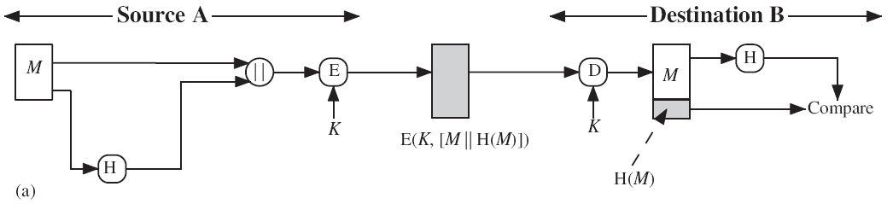
Applications of Cryptographic Hash Function
The message plus concatenated hash code is encrypted using symmetric encryption. Because only A and B share the secret key, the message must have come from A and has not been altered. The hash code provides the structure or redundancy required to achieve authentication. Because encryption is applied to the entire message plus hash code, confidentiality is also provided.

Slide 21
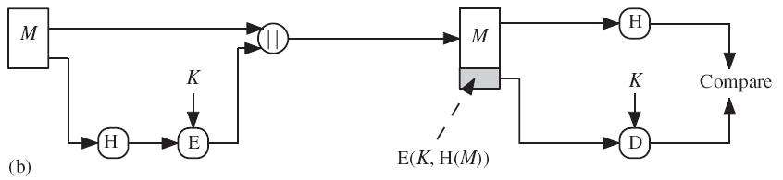
Applications of Cryptographic Hash Function
Only the hash code is encrypted, using symmetric encryption. This reduces the processing burden for those applications that do not require confidentiality.

Slide 22
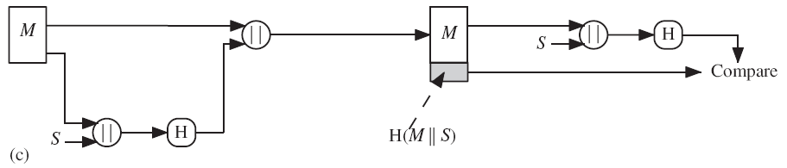
Applications of Cryptographic Hash Function
It is possible to use a hash function but no encryption for message authentication. The technique assumes that the two communicating parties share a common secret value S.A computes the hash value over the concatenation of M and S and appends the resulting hash value to . Because B possesses , it can recompute the hash value to verify. Because the secret value itself is not sent, an opponent cannot modify an intercepted message and cannot generate a false message.

Slide 23
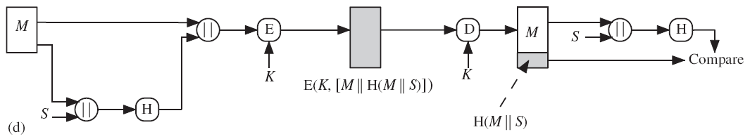
Applications of Cryptographic Hash Function
Confidentiality can be added to the approach of method (c) by encrypting the entire message plus the hash code.

Slide 24
Applications of Cryptographic Hash Function
When confidentiality is not required, method (b) takes less computation time as compared to methods (a) and (d).
There has been growing interest in techniques that avoid encryption . Several reasons for this interest are :
Encryption software is relatively slow.
Encryption hardware costs are not negligible.
Encryption hardware is optimized toward large data sizes. For small blocks of data, a high proportion of the time is spent in initialization/invocation overhead.
Encryption algorithms may be covered by patents, and there is a cost associated with licensing their use.

Slide 25
Applications of Cryptographic Hash Function
More commonly, message authentication is achieved using a Message Authentication Code (MAC), also known as a keyed hash function.
Typically, MACs are used between two parties that share a secret key to authenticate exchanged information
A MAC function takes as input a secret key and a data block and produces a hash value, referred to as the MAC.
This can then be transmitted with or stored with the protected message.

Slide 26
Applications of Cryptographic Hash Function
If the integrity of the message needs to be checked, the MAC function can be applied to the message and the result compared with the stored MAC value.
An attacker who alters the message will be unable to alter the MAC value without knowledge of the secret key.
Verifying party also knows who the sending party is because no one else knows the secret key.

Slide 27
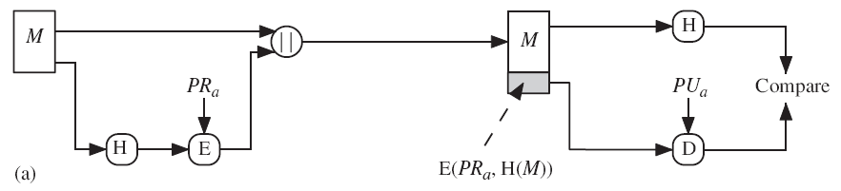
Applications of Cryptographic Hash Function
The hash code is encrypted, using public-key encryption with the sender’s private key. This provides authentication and digital signature.

Slide 28
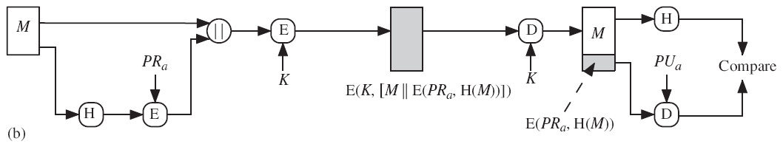
Applications of Cryptographic Hash Function
If confidentiality as well as a digital signature is desired, then the message plus the private-key-encrypted hash code can be encrypted using a symmetric secret key. This is a common technique.

Slide 29
Applications of Cryptographic Hash Function
Other Applications
To Create One way Password File
Intrusion detection
Virus detection

Slide 30
Applications of Cryptographic Hash Function
To Create One way Password File
Hash functions are commonly used to create a one-way password file. A hash of a password is stored by an operating system rather than the password itself.
Actual password is not retrievable by a hacker who gains access to the password file.
When a user enters a password, the hash of that password is compared to the stored hash value for verification.

Slide 31
References
http://www.brainkart.com/article/Classical-Encryption-Techniques_8339/
https://www.tutorialspoint.com/cryptography/index.htm
https://www.geeksforgeeks.org/cryptography-introduction/
https://www.techopedia.com/definition/1770/cryptography#:~:text=Cryptography%20involves%20creating%20written%20or,information%20to%20be%20kept%20secret.&text=Information%20security%20uses%20cryptography%20on,transit%20and%20while%20being%20stored.
https://www2.slideshare.net/lineking/classical-encryption-techniques-in-network-security?qid=e388c29f-793d-4f2b-bcaf-9d22e9ca07b5&v=&b=&from_search=1

Slide 32
E- Books Recommended
https://www.pdfdrive.com/cyber-security-books.html
https://bookauthority.org/books/new-cyber-security-ebooks
https://bookauthority.org/books/best-cyber-security-ebooks
https://www.freetechbooks.com/information-security-f52.html

